Slide 1
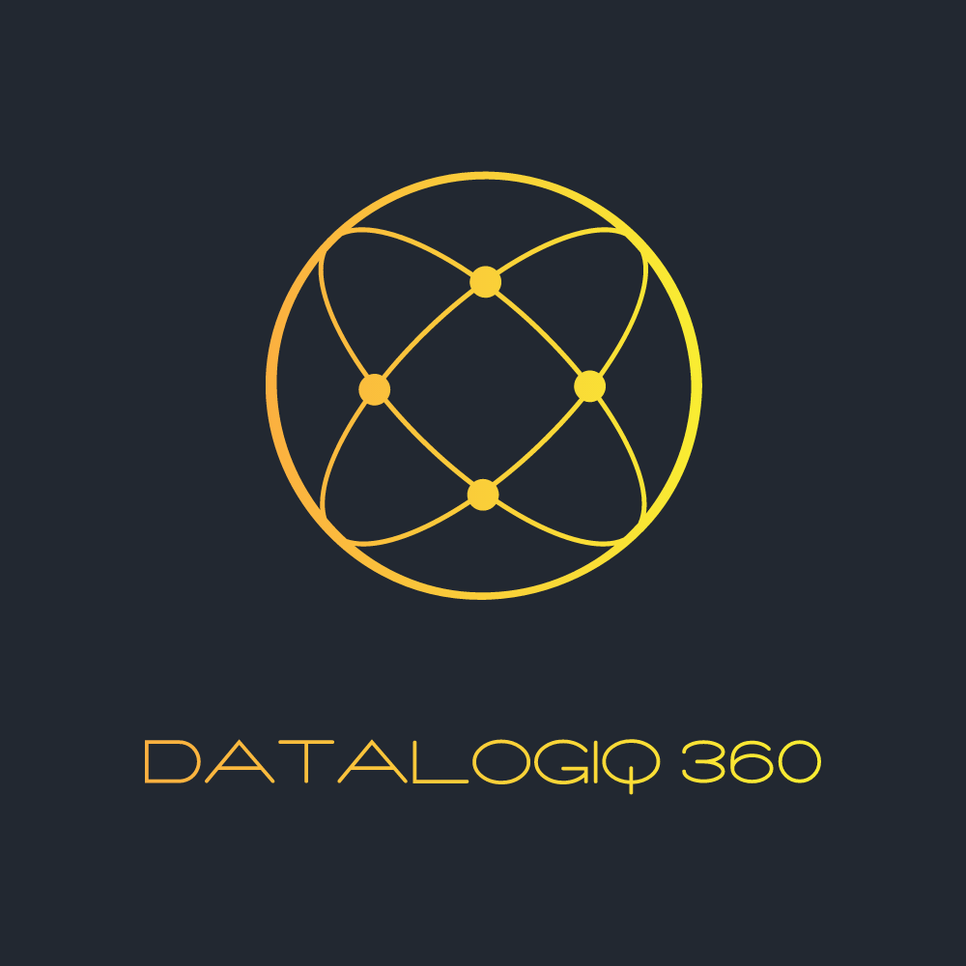
Change Management Toolkit
August 22, 2023

Slide 2
Change Management Toolkit:
Organizational and individual change management are each executed using different methods
Organizational
Organizational change is accomplished through executing the workstreams to pilot and implement the future state of Data, leading to:
Identifying the organizational challenge and solution
Finding and training the people needed to make the future state work
Developing required policies and procedures
Modifying or acquiring needed tools and enablers
Individual
Individual change is accomplished by modeling behavior, excellent communications, and reinforcement of desired behavior, helping the individual understand:
Why change is coming
What’s in it for them and their organization
How their job will change
How they’ll get the skills and support they need to succeed following the change

